Slide 1
Security Automation – all you need to know
ISSA Polska – Stowarzyszenie ds. Bezpieczeństwa
Systemów Informacyjnych,
Lech Lachowicz
Dyrektor ds. Profesjonalnego Rozwoju
Warszawa, 28-02-2021r.

Slide 2

Disclaimer
Who am I:
IT Security freak with decent background in dev
Global Threat Defense lead responsible for detections, hunting, automation and breach simulation
Big fan of opensource and automation
Who I’m not:
NOT a full time Developer
NOT A DEVOPS
NOT Alfa and Omega, you can actually do it differently
What is it going to be about:
Better SECURITY

Slide 3
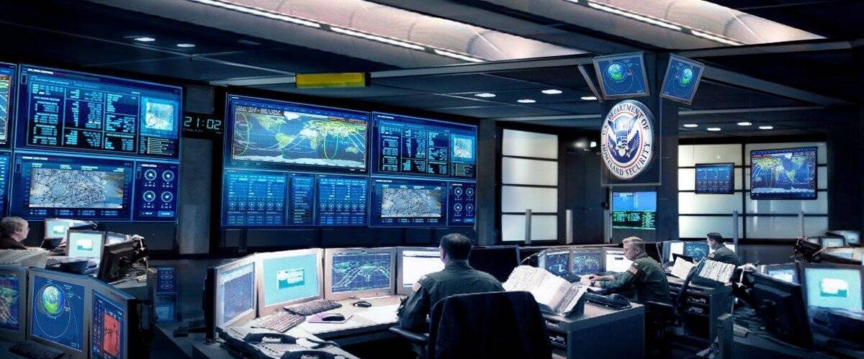
Current security operations challenges
Increasing volume and complexity of attacks
67%
of organizations say volume of attacks is increasing
Expanding compliance and obligations
72 hours
to comply with mandatory breach reporting for GPR
Challenging operational environments
26 or more
security products managed on average by organizations

Slide 4
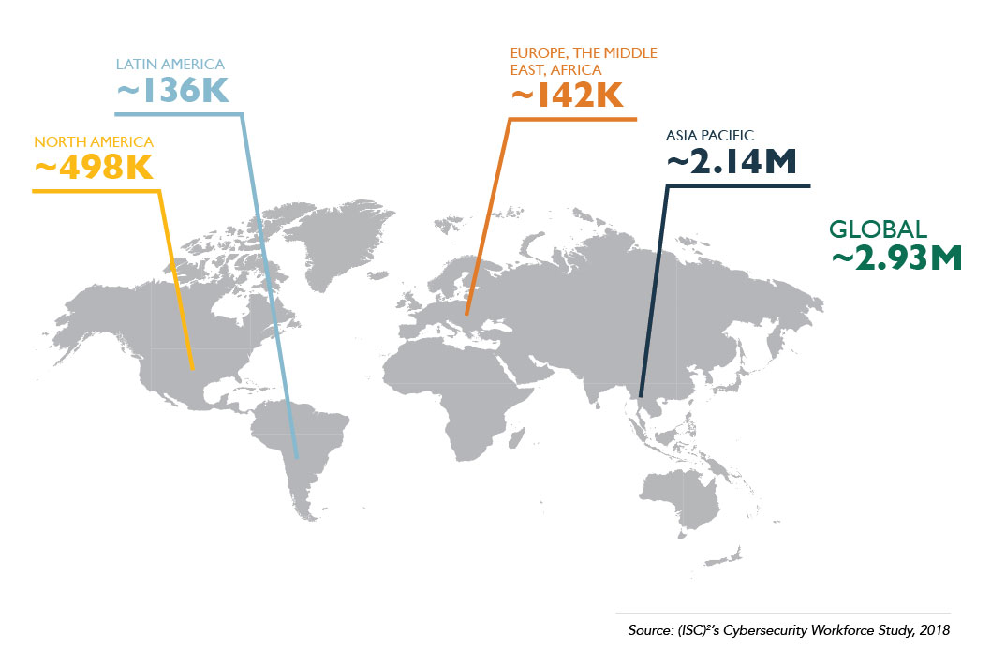
Skills shortage

Slide 5
Security Operations need to
Minimize duration and impact of cyber attacks
Optimize SecOps and reduce staff burnout
Address breach reporting requirements and show compliance
Maximize security investments and scale insights across teams
So we automate

Slide 6
Areas to automate
Security operations
Software and product security
Threat detection and response
Threat exposure and vulnerability management
Application inventory tracking
Secure development gates
Security validation and remediation
Governance
Security program governance
Security controls tracking and validation
Digital identity and access
Access fulfilment
Access certification
Manual access appropriateness check and automated alert notifications

Slide 7
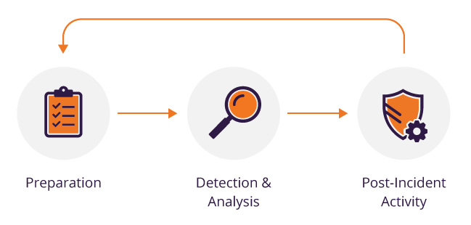
Threat Detection and Response

Slide 8
Key Parameters
Exposed to Threats
Resilient to Threats
Months
MEAN-TIME-TO-DETECT (MTTD) The average time it takes to recognize a threat requiring further analysis and response efforts
MEAN-TIME-TO-RESPOND (MTTR)
The average time it takes to respond and ultimately resolve the incident
Weeks
Days
MTTD & MTTR
Hours
As organizations improve their ability to quickly detect and respond to threats, the risk of experiencing a damaging breach is greatly reduced
Minutes
High Vulnerability
Low Vulnerability

Slide 9
Security Orchestration Automation and Response
Alerts
Automatic/ Manual Response and Remediation
App Logs
SIEM
Create Helpdesk Ticket
F/W Logs
Gather Forensics
SOAR
Workflow
Automation
Case Management
Collaboration
Disable Account
DHCP Logs
Endpoint Activity
Threat data
Related Logs
Manually invoked enrichment
Automatic enrichment
Vulnerability Management
Web gateway
VirusTotal

Slide 10
Anatomy of phishing attack
Broadcast phishing email to a user group
Cross the trust barrier
Infect
Monetize
User receives the legitimate looking email from a known contact, forwards it to SPAM box
User puts his credentials
Next step is to replicate the email to everyone ever emailed
30
50
60
Time (min)
10
20
40
User clicks on the link and is taken to genuine O365 login page
Attacker now has full access to O365 account
Steal data, user info, ask for Ransom

Slide 11

The process for handling Phishing emails
# | Action | Current manual time spent (sec) | Current manual time spent - Explanation
A | Have a look at the email content | 30 | Need to download the email, open it and save a screenshot
B | Collect email header | 60 | Need to grab the email header then run it into a parsing script/tool and finally attach the data into the ticket
C | Check URL & determination | 300 | Need to manually check it against VT/OSINT, test it within Safe Browser and document it into IOC feeds. Finally determine if bad
D | Check attachment & determination | 300 | Need to grab the sample, detonate it manually in Sandbox, create IOC and attach the report into Incident
E | Check downloaded malware & determination | 300 | Need to grab the sample, detonate it manually in Sandbox, create IOC and attach the report into Incident

Slide 12
The times after automation
# | Action | Current manual time spent (sec) | Current manual time spent - Explanation | New manual time spent (sec) | New manual time spent - Explanation | Manual time saved (sec)
A | Have a look at the email content | 30 | Need to download the email, open it and save a screenshot | 5 | Screenshot already present in the Incident | 25
B | Collect email header | 60 | Need to grab the email header then run it into a parsing script/tool and finally attach the data into the ticket | 5 | Header already displayed in the Incident, with quick spoof check for determination | 55
C | Check URL & determination | 300 | Need to manually check it against VT/OSINT, test it within SafeBrowser and document it into IOCs. Finally determine if bad | 120 | OSINT is automatically gathered, and IOCs created. URL is detonated in Sandbox. Use Sandbox score and OSINT for determination. | 180
D | Check attachment & determination | 300 | Need to grab the sample, detonate it manually in Sandbox, create IOC and attach the report into Incident | 60 | IOC already created with Sandbox report, for quick determination | 240
E | Check downloaded malware & determination | 300 | Need to grab the sample, detonate it manually in Sandbox, create IOC and attach the report into Incident | 60 | IOC already created with Sandbox report, for quick determination | 240

Slide 13
Demo
Lets build a sample playbook.

Slide 14


Slide 15



Breach and attack simulation platform
A tool for Security Control Validation
Simulate TTPs to test defenses
Visualize exposures with data-driven results
Holistically remediate to defend infrastructure

Slide 16
Sample Breach Simulation Scenarios
Security Control Validation
Organization wide Security Posture
Posture Assessment per OU/BU
Environmental Drift Detection
MITRE ATT&CK Assessment
Endpoint Techniques Assessment
Email Security Assessment
Perimeter Validation
Data Leakage Assessment
Segmentation Control Validation
Compare Security Controls Efficacy
SOC/IR Validation
M&A Risk Assessment
Threat Assessment
Imminent Threat Assessment
MITRE Threat Actor Assessment
TI Integrated Assessment
Cloud Security Assessment
Cloud Threats Assessment
CWPP Control Validation
Configuration Control Validation
Risk Based VM
Vulnerability Prioritization
Vulnerability Prioritization by Threat

Slide 17
Organization wide Security Posture
Description
Assessment of overall security posture based on continuous baseline assessment and tracking over time
Produce risk reports to track at the executive level
Produce operational reports to drive remediation processes
Benefits
Uniform KPIs across organization and programs
Common terminology across different teams
Track program progress over time against a clear target
Proven attack surface reduction based on data
Prove overall effectiveness
Examples
Validating security controls effectivenes for different assets and environments
Users / Roles
Security Operations
CISO & Executives

Slide 18
Environmental Drift Detection
Description
Continuous evaluation of security posture on a target environment against a baseline performance
Monitoring deviations from the baseline performance
Baseline performance can be defined in terms of detection, prevention or both
Can target static/dynamic threat landscape to measure
Benefits
Ensure a certain performance level is maintained against a threat or a reference set of attacks.
Alert on deviation and reduce time to resolution
Clear remediation steps to return to baseline
Examples
Corporate network vs. Remote Workforce Threats
Production DC vs. Data Theft
Corporate vs. Credential Access
Validating Alerting state
Users / Roles
Security Engineering
SOC
Security Managers

Slide 19
Segmentation Control Validation
Description
Comprehensive validation of Network security against Lateral Movement attacks and techniques
Lateral movement and credential abuse validation
Wide threat coverage and malware infection techniques between hosts in the network
Benefits
Focus on segmentation security and ability to enhance email security gateway coverage
Validation of segmentation security posture over time against an evolving threat landscape
Enablement of remediation efforts on a defined scope
Examples
Validation of network security vs. Brute Force techniques
Validation of windows networks remote control techniques
Validation of network inspection vs. Ransomware propagation attacks
Validating Azure NSG Deployment.
Users / Roles
Security Operations
Network Security
Security Managers

Slide 20
MITRE Threat Actor Assessment
Description
Assessment of overall security posture vs. a threat actor TTPs
Evaluate overall organization risk vs. a threat actor.
Produce operational reports to understand gaps and plan remediation
Benefits
Consistent assessment and ability to review change over time
Focus on relevant threats for the organization
Clear quantifiable data on security posture
Examples
Assessment of security posture vs. APT29 TTPs
Users / Roles
Security Operations
Threat Intelligence
CISO & Executives

Slide 21
Cloud Threats Assessment
Description
Assessment of cloud security posture vs. cloud specific threats.
Evaluate overall cloud security posture vs. a cloud baseline set of attacks and techniques.
Produce operational reports to understand gaps and plan remediation
Benefits
Consistent assessment and ability to review change over time
Ability to take a data driven approach to enable cloud transition
Validate enforcement of cloud policies and generate visibility to effectiveness
Examples
Assessment of overall cloud security posture vs. SafeBreach cloud baseline
Assessment of overall cloud security program based on MITRE ATT&CK
Assessing visibility and understanding the gaps in newly created Azure subscriptions.
Users / Roles
Security Operations
Cloud Security
CISO & Executives

Slide 22





















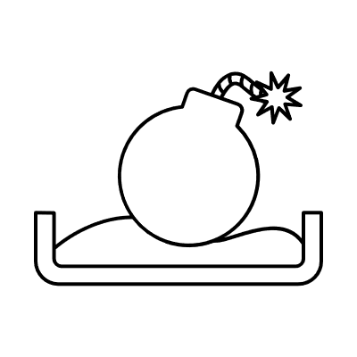
Win Server
Linux Server
IPS / IDS
Console
Server Zone
Win Server
Linux Server
Crown Jewels Zone
Virtual Ethical Hacker
Win10
Win7
Mac
Access Zone / DMZ
User Zone
Notes:
Understanding security posture enables the Security and IT teams to:
measure the effectiveness of network, cloud, email and endpoint security controls
Improve the ROI on security tools
Validate and report on effectiveness against threat specific groups, tactics, techniques and malware types
Risk assessment for M&A or supply chain network integrations
Scale Red Team playbook of attack methods

Slide 23
Sample dashboard
Sample Dashboard
blocked
missed
detected
reacted
noticed
Enterprise network
Enterprise DMZ
Azure
OT Infrastructure 1
OT Infrastructure 1
Key Critical environment
Detection efficacy for “in the wild” scenarios
Missed – no signals from security tools
Blocked – security tools blocked the threat
Noticed – security tools signaled activity (event has been generated) but no alert has been generated
Detected – security tools signaled activity and alert has been generated but not escalated for remediation
Reacted – security tools signaled activity and alert has been generated, IR has been notified via SIR

Slide 24
Demo
Lets build a sample scenario.

Slide 25
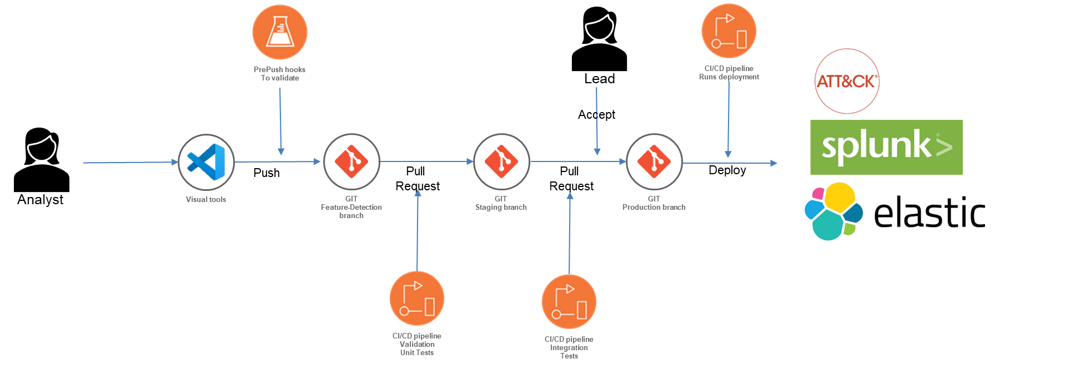
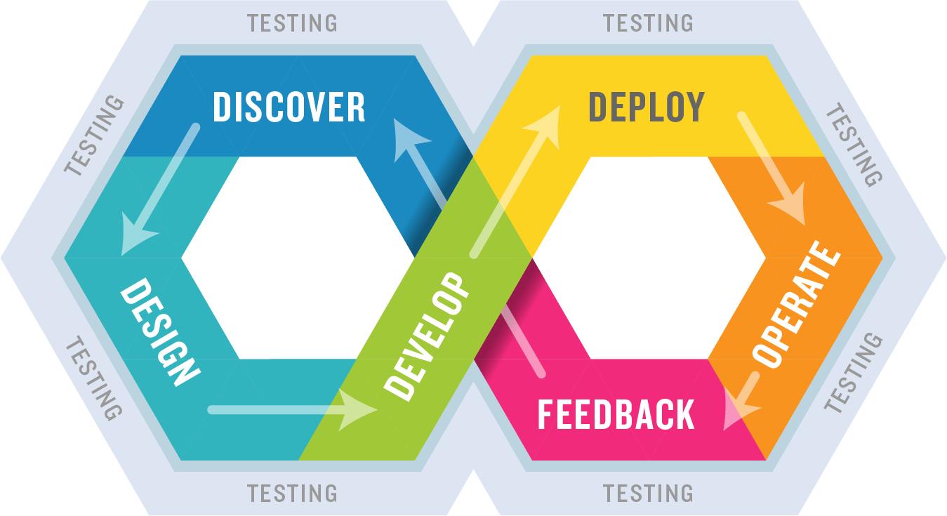
Shift Left Detection
CTI/OSINT
Detection opportunity
Develop detection
Test detection
Detection Pipeline
Multiple approvers
Automated testing (basic linting and integrations)
Importers from other detection sources (Sigma, SSC etc).
Reporting
Continuous validation

Slide 26
The benefits
Reliable
Operate 365 days a year!
Retention
Freed up human resources for higher value-added tasks
Productivity
Accelerate detection and response
Consistent
Eliminating variations in processes
ROI
20–35% savings
Fast
Automatically deploy security controls
Audit trail
Fully maintained logs for compliance
Scalable
Ramp up and down
to match demand
Visibility
Single pane of glass

Slide 27


Questions

Slide 28
Thank you
Lech Lachowicz
Mail to: lech.Lachowicz@issa.com.pl

